Slide 1

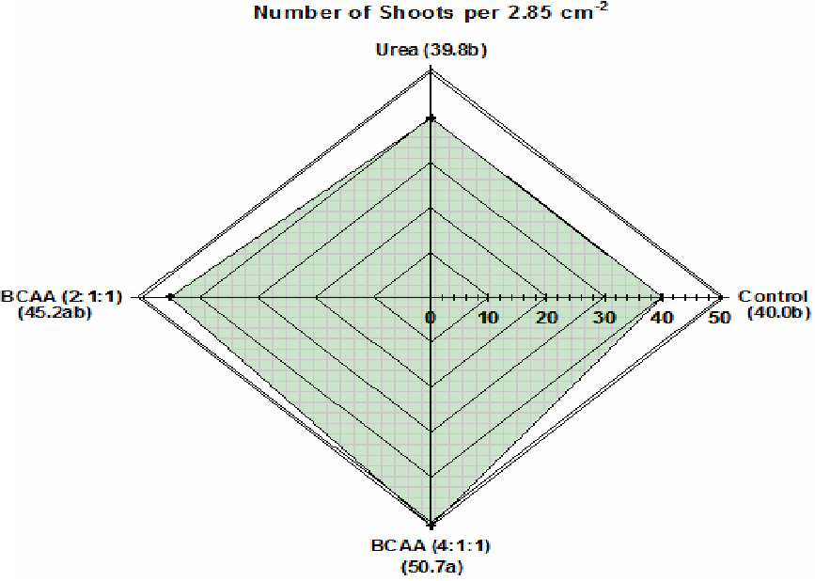
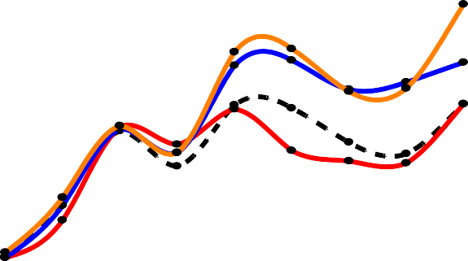
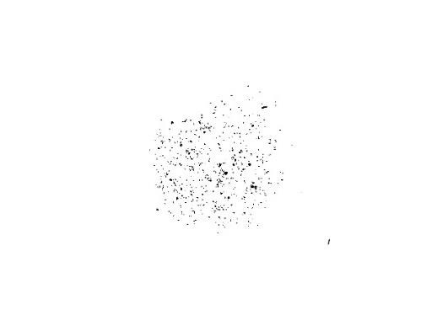





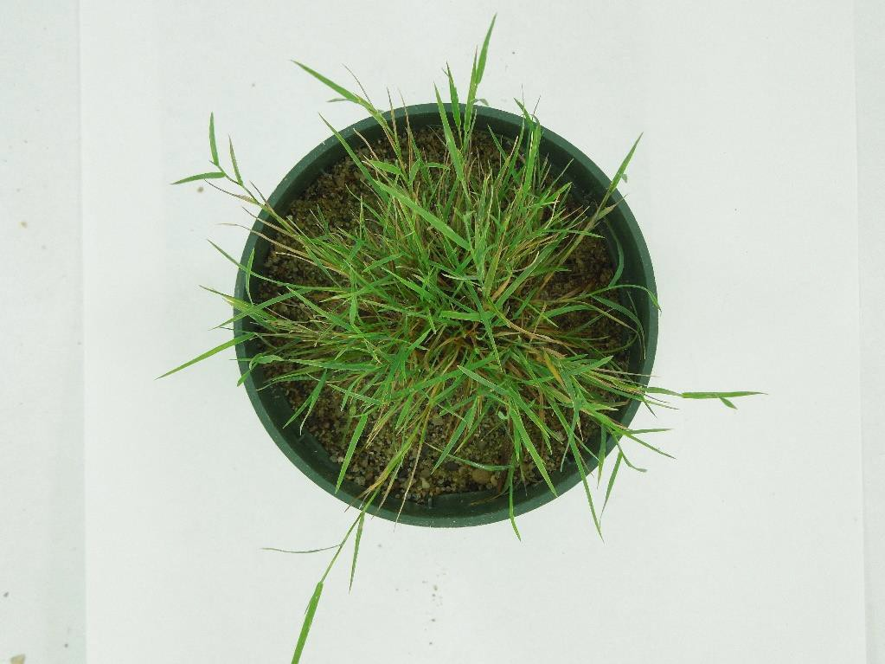
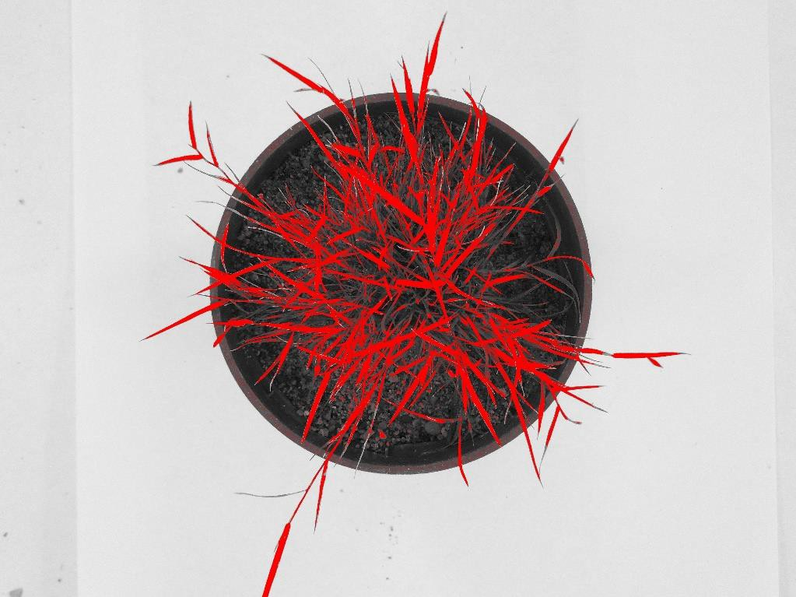
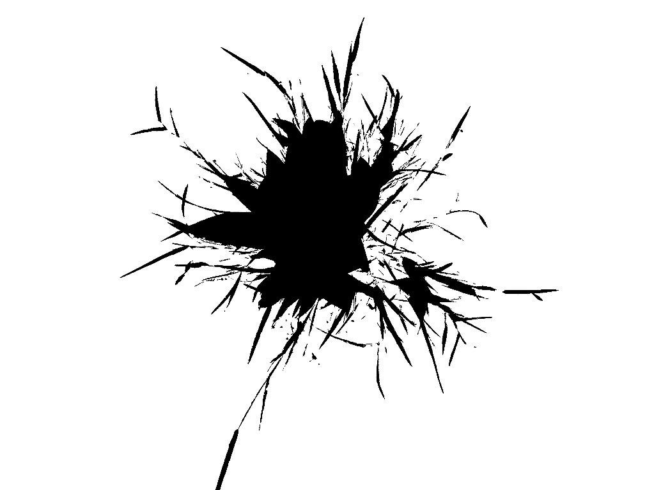
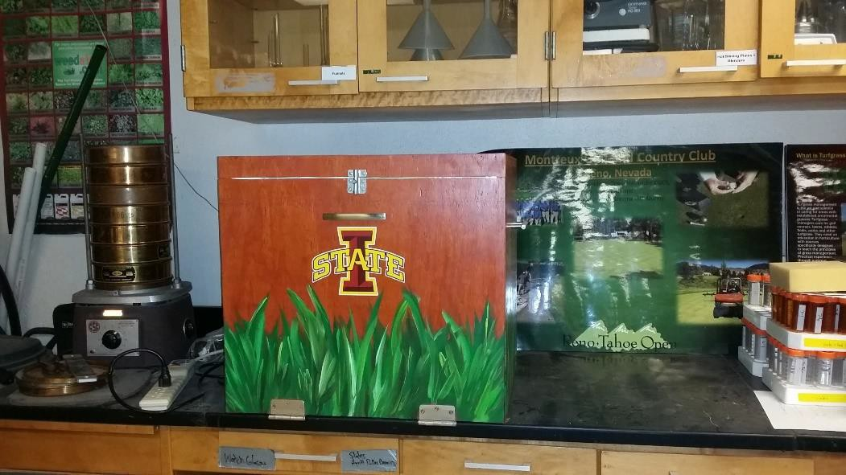
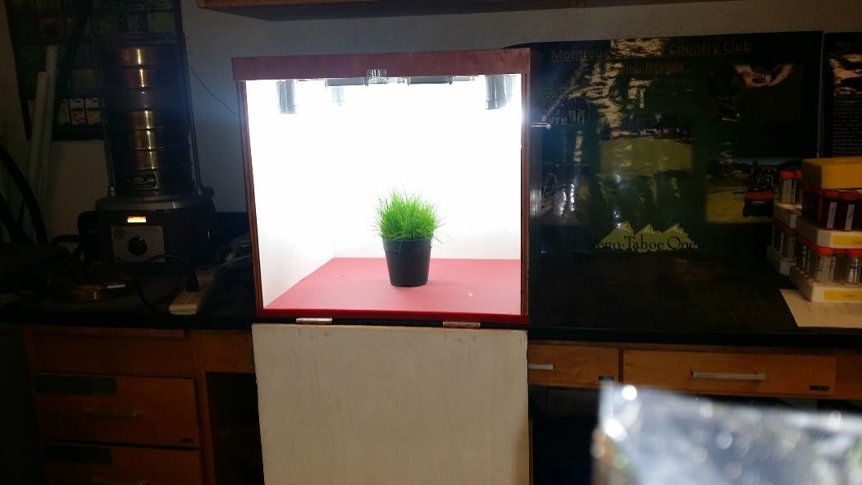
Evaluation of Creeping Bentgrass (Agrostis stolonifera L.) Responses to
Foliarly Applied Branched-Chain Amino Acids
I.T. Mertz, N.E. Christians
Department of Horticulture, Iowa State University, USA
Introduction
The branched-chain amino acids (BCAA) leucine, isoleucine, and valine are synthesized in plants and are essential to growth in most organisms. Research has shown that when foliarly applied, these compounds can be absorbed by the plant, however, plant catabolism of BCAA is not completely understood. Since the BCAA compounds contain nitrogen in their chemical structure, they could potentially be used an organic nitrogen source in plants. In previous research, the application of a BCAA containing solution to creeping bentgrass (Agrostis stolonifera L.) putting greens resulted in increased plant shoot density compared to applications of mineral nutrition only, indicating a potential benefit to their use. However, the BCAA and nitrogen (N) concentrations in that product led to in some cases, excessive product application rates that did not make its use economical. Following a metabolomics analysis of the product, efforts were made to improve the viability of its use.
ImageJ Calibration
0.5
LSD = 0.049
0.440a
0.5
LSD = 0.087
ImageJ was used to track the area of coverage/growth rate of each sample. Weekly pictures taken with a light-box were used for DIA. While there is a plethora of literature over turfgrass and DIA, the majority of that work involves the use of pictures taken in the field. This study attempted to use DIA on samples grown in a controlled environment. For this study, the color threshold of each image was adjusted to include only green pixels. The threshold ranges used for this study included Hue (0-97), Brightness (92-255), and Saturation (110-255). While these numbers differ from those in the literature, the calibration curve below illustrates their capability for our application. After calculation of the area covered in cm⁻² by DIA software, this number was entered into the calibration equation, and then divided by the pot surface area (71.25 cm⁻²) in order to calculate the percent cover of each pot.
Above-Ground Shoot Weight (g)
0.4
0.365b
0.396ab
0.404ab
Rooting Biomass (g)
0.4
0.378a
0.3
0.3
0.277b
0.276b
0.325ab
0.2
0.2
0.1
0.1
0.0
Control
Urea
Treatment
BCAA (2:1:1) BCAA (4:1:1)
0.0
Control
Urea
Treatment
BCAA (2:1:1) BCAA (4:1:1)
FIGURE-1: Above-ground shoot weight responses of creeping bentgrass to treatment
application. Bars sharing the same letter are statistically similar at α = 0.05.
FIGURE-2: Root biomass responses of creeping bentgrass to treatment
application. Bars sharing the same letter are statistically similar at α = 0.05.
Primary Objective
Evaluate and compare creeping bentgrass responses to foliarly applied BCAA versus applications of equivalent mineral nutrition only.
Masks Generated During ImageJ Calibration
40
35
30
25
20
15
10
Pot Percent Cover (%)
Materials & Methods
Completely randomized design with 15 replications
Creeping bentgrass ‘007’ plugs taken from field and grown in 9.5-cm diameter pots in greenhouse
Treatments were applied on a 14-d interval and were based on an equal rate of N (3.4 kg N ha⁻¹). All samples received an additional application of urea at 3.4 kg N ha⁻¹ halfway through each 14-d treatment interval.
All treatments and additional fertilizer applications were applied foliarly, with irrigation being withheld until 24-h post application.
Supplemental radiation was provided when day-time irradiance dropped below 200 µmol m⁻² s⁻¹ to ensure a consistency of 16 hours of light per day, and ranged from 350 to 385 µmol m⁻² s⁻¹.
Air temperature ranged from 22.3 to 23.6°C
Relative Humidity ranged from 24.3 to 44.7%
Samples were mist watered with 2 ml, 4 times daily, until rooting occurred
At the point samples had established roots, watering was transitioned to 2.54-cm per week
A total of 4 treatment applications occurred during the duration of the study
A light-box was used to record weekly digital images of each sample in order to track growth and spreading rates.
Samples were harvested 8 weeks after transplanting, or at 42-d following initial treatment.
Measurements included rooting biomass (g), above-ground shoot weight (g), shoot density (# shoots 2.85-cm⁻²), and area of coverage through digital image analysis (DIA)
0% Coverage
20% Coverage
40% Coverage
0
7 14 21 28* 35* 42* 49* 56*
Control Urea
BCAA (2:1:1)
BCAA (4:1:1)
Days After Initial Treatment
FIGURE-3: Creeping bentgrass shoot density (shoots⁻¹ 2.85-cm⁻²) responses to treatment application. Data next to treatment labels are statistically similar at α = 0.05.
FIGURE-4: Creeping bentgrass average growth responses of each treatment overtime, in terms of the percent area being covered by green vegetation in each pot. Dates with * or ** indicates a significant difference among treatments at p ≤ 0.05 and ≤0.0001, respectively.
60% Coverage
80% Coverage
100% Coverage
)
70
60
50
40
30
20
10
0
y = 0.8032x + 2.7481
R² = 0.9644
Area Calculated by ImageJ (cm²
These pictures illustrate the process each image had to undergo in order for the ImageJ software to quantify the number of green pixels of each sample.
0 20 40 60 80
Calculated Area (cm²)
FIGURE-5: Calibration curve generated based on actual area of turfgrass plug with known measurements vs amount of area calculated by ImageJ using the parameters stated above.
Results/Conclusions:
At trial end (42-days), plants that received applications of leucine, isoleucine, and valine in a 4:1:1 ratio exhibited a 37% and 27% increase in rooting and shoot density respectively, compared to those receiving urea only. When applied in a 2:1:1 ratio, those increases were less pronounced (18% and 13.5% increase in rooting and shoot density respectively, compared to urea only). This indicates that in terms of plant performance, BCAA may be suitable for the substitution of urea when fertilizing creeping bentgrass. Shoot density of creeping bentgrass is of the upmost importance, and can be directly related to playing surface quality. Due to the increases in shoot density observed, these results also show the potential increased benefits of including an organic source of nitrogen in a fertilizer program, however, further research is needed in order to fully understand plant catabolism of BCAA.
While the potential benefits are indicated in this study, further research needs to be done. Future studies will focus on the use of isotopic forms of the BCAA, as well as their effect on growth under less optimal conditions. This work will hopefully lead us to a better understanding of BCAA catabolism by plants, furthering our knowledge of the turfgrass plant
Treatment List
Weekly pictures of each sample were taken with a light-box in order to track the growth/spreading rate in each pot, these pictures were used for DIA in ImageJ.
Treatment | Product | Rate (kg Product/ha) | Rate (kg N/ha)
1 | Control | - | -
2 | Urea | 7.4 | 3.4
3 | BCAA (2 : 1 : 1)* | 15 : 7.5 : 7.5 | 3.4
4 | BCAA (4 : 1 : 1)* | 20 : 5 : 5 | 3.4
Contact:
Isaac Mertz
Iowa State University Department of Horticulture Ames, IA, USA 50011
imertz@iastate.edu
Dr. Nick Christians Iowa State University
Department of Horticulture Ames, IA, USA 50011
nchris@iastate.edu
* BCAA Treatments consisted of L-valine:L-leucine:L-isoleucine

